Slide 1
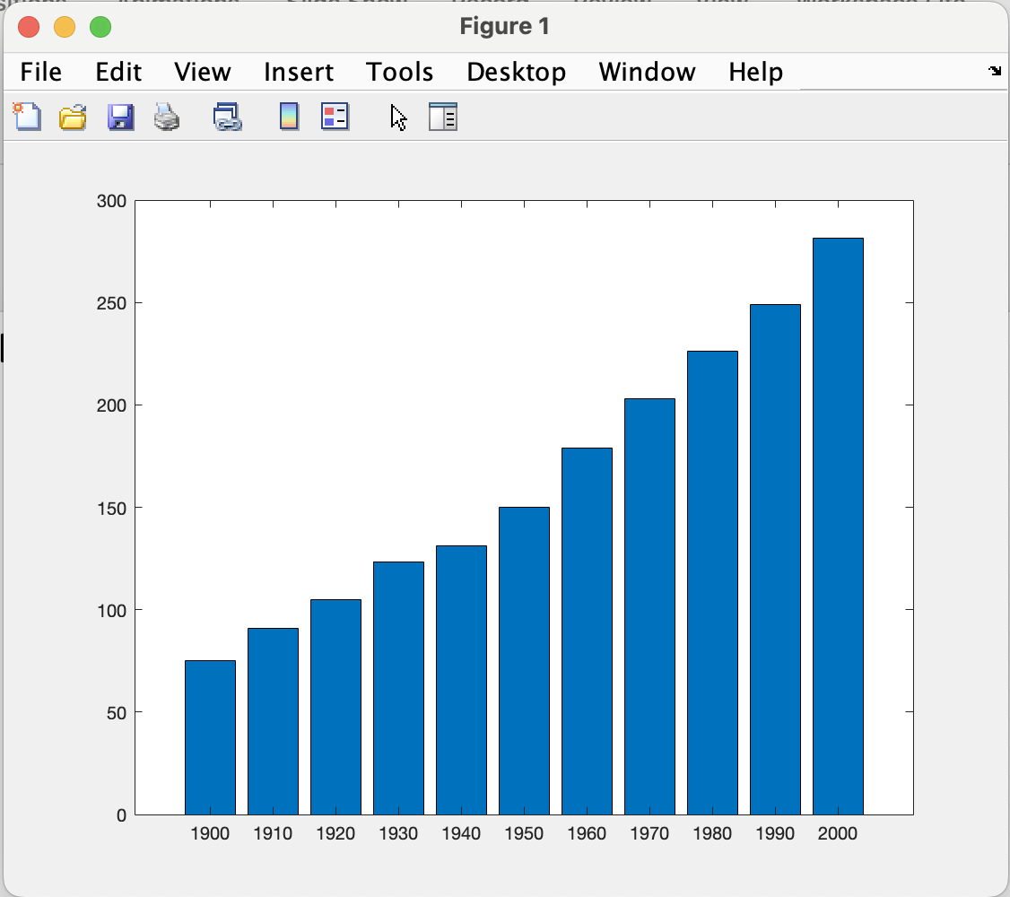
Bar graph
figure(1);
x = 1900:10:2000;
y = [75 91 105 123.5 131 150 179 203 226 249 281.5];
bar(x,y)

Slide 2
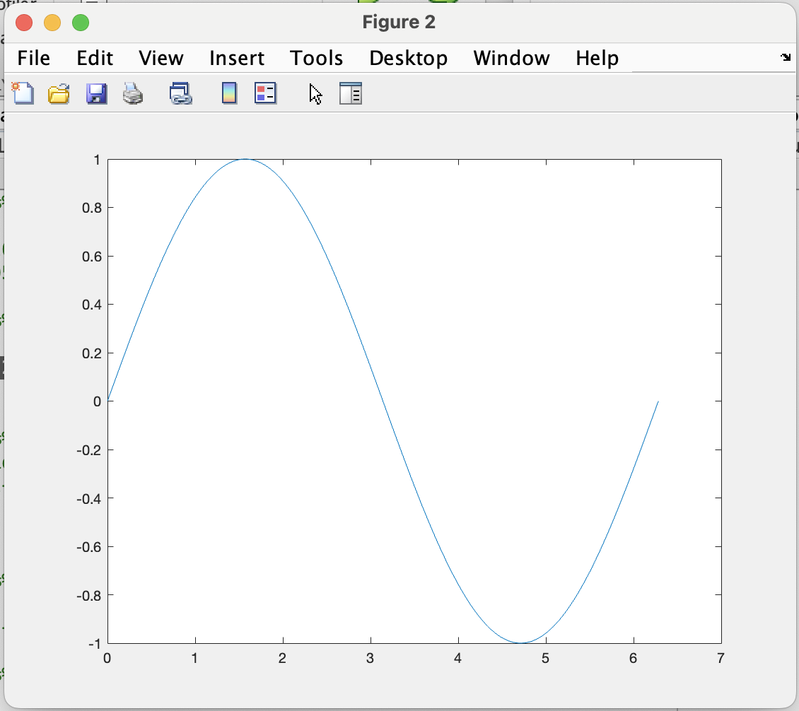
Plot graph
figure(2)
x = 0:pi/100:2*pi;
y = sin(x);
plot(x,y)

Slide 3
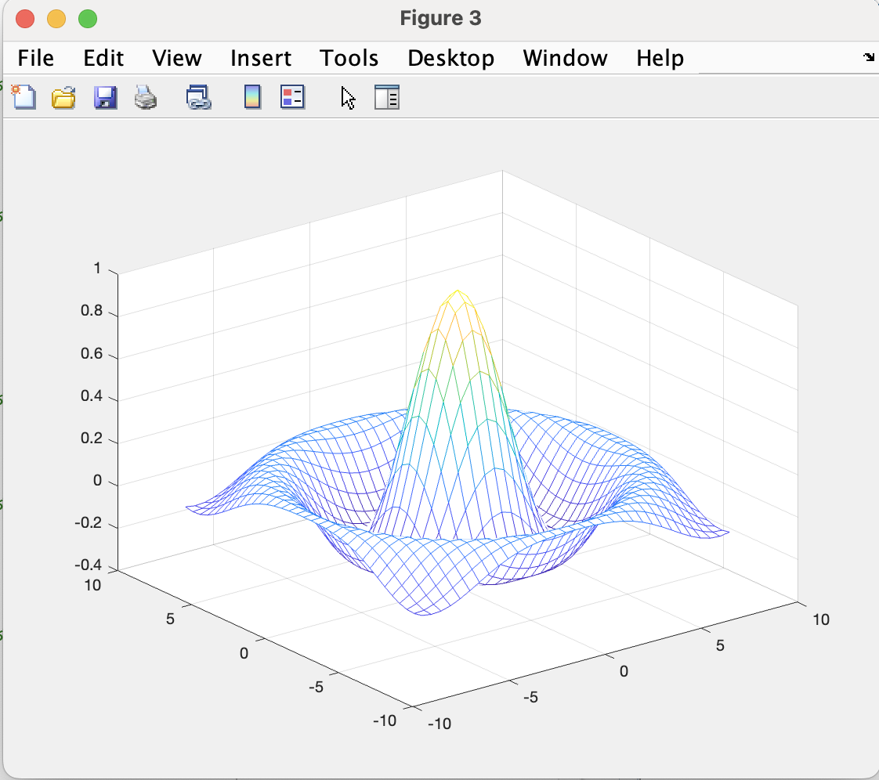
mesh
figure(3) % Create a new figure window with the figure number 3
[X, Y] = meshgrid(-8:0.5:8); % Create a grid of 2D coordinates using meshgrid
R = sqrt(X.^2 + Y.^2) + eps; % Calculate the radial distance from the origin with a small epsilon added
Z = sin(R) ./ R; % Compute the function values based on the radial distance
mesh(X, Y, Z) % Create a 3D mesh plot using the generated data

Slide 4
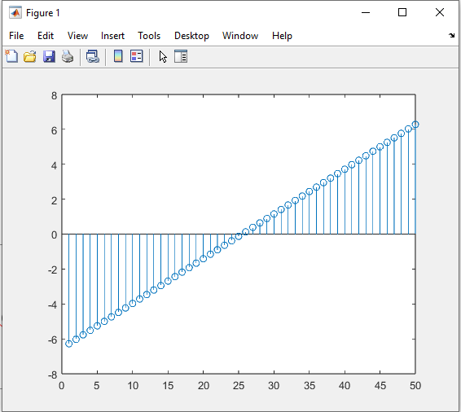
Stem
Y = linspace(-2*pi,2*pi,50);
stem(Y)

Slide 5
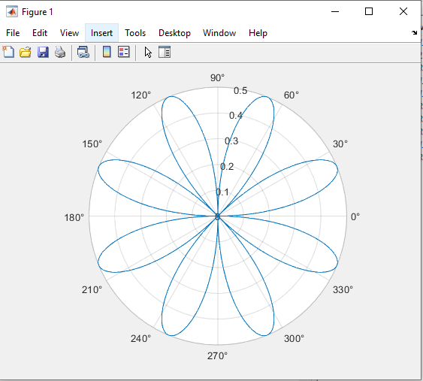
Polar
theta = 0:0.01:2*pi;
rho = sin(2*theta).*cos(2*theta);
polarplot(theta,rho)

Slide 6
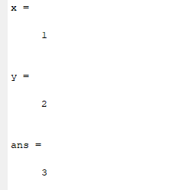
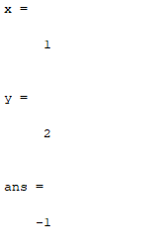
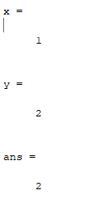
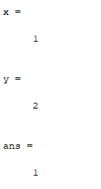
x=1
y=2
x+y
x=1
y=2
x-y
x=1
y=2
x*y
x=1
y=2
x^y

Slide 7
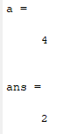
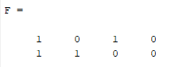
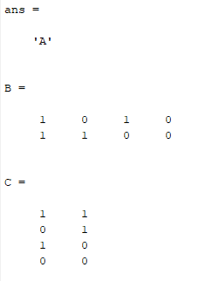
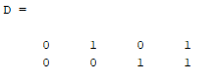
a=4
sqrt(a)
F=[1 0 1 0;1 1 0 0]
A='ABC';A(2,:)='EFG';
A(1,1)
B=[1 0 1 0;1 1 0 0]
C = B'
B=[1 0 1 0;1 1 0 0]
D = fliplr(B)

Slide 8
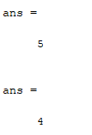
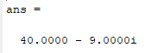
x = 5+4j
real(x)
imag(x)
(5+4j)*(4-5j)
sqrt(20*24/7-12^4)+exp(1.32)
cos(pi)+sin(pi)
ans =
3.7434e+00 + 1.4376e+02i
ans =
-1.0000

Slide 9
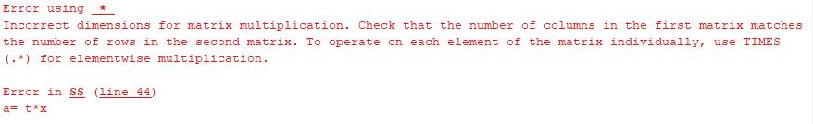
t=[1,2,3,4];
x=[1,2,3,4;5,6,7,8]
a= t*x
t=[1,2,3,4];
x=[1,2,3,4;5,6,7,8]
a= t*x'
a =
30 70

Slide 10
A =
1 2
3 4
B =
5 6
7 8
ans =
5 12
21 32
ans =
19 22
43 50
A=[1,2;3,4]
B=[5,6;7,8]
A.*B
A*B

Slide 11
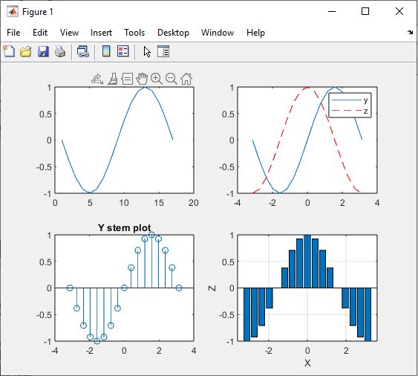
%clear history and memory before the code is executated
clear all, clc
%define vector x function y and z
x=[-pi:pi/8:pi];
y=sin(x);
z=cos(x);
%subplot 1
subplot(221)
plot(y); %plot y only
%subplot 2
subplot (222)
plot(x,y),hold on; %plot y versus x, and hold
plot(x,z,'r--'),hold off;%plot z versus x with
legend('y','z')
%subplot 3
subplot(223)
stem(x,y)%pot y versus x in discrete sequence
title('Y stem plot')
%subplot 4
subplot(224),bar(x,z);%plot z vs x using bar chart
xlabel('X'),ylabel('Z');%add labels to the figure
grid on;%add grid to the figure

Slide 12
clear, clc;
k = 20;
a = zeros(k,k);%Preallocate matrix
for m = 1:k %outer loop
for n =1:k %inner loop
a (m,n)=1/(m+n-1);%ststement
end %End for innerloop
end % End for outer loop
ones(m,n)
ans =
Columns 1 through 18
1 1 1 1 1 1 1 1 1 1 1 1 1 1 1 1 1 1
1 1 1 1 1 1 1 1 1 1 1 1 1 1 1 1 1 1
1 1 1 1 1 1 1 1 1 1 1 1 1 1 1 1 1 1
1 1 1 1 1 1 1 1 1 1 1 1 1 1 1 1 1 1
1 1 1 1 1 1 1 1 1 1 1 1 1 1 1 1 1 1
1 1 1 1 1 1 1 1 1 1 1 1 1 1 1 1 1 1
1 1 1 1 1 1 1 1 1 1 1 1 1 1 1 1 1 1
1 1 1 1 1 1 1 1 1 1 1 1 1 1 1 1 1 1
1 1 1 1 1 1 1 1 1 1 1 1 1 1 1 1 1 1
1 1 1 1 1 1 1 1 1 1 1 1 1 1 1 1 1 1
1 1 1 1 1 1 1 1 1 1 1 1 1 1 1 1 1 1
1 1 1 1 1 1 1 1 1 1 1 1 1 1 1 1 1 1
1 1 1 1 1 1 1 1 1 1 1 1 1 1 1 1 1 1
1 1 1 1 1 1 1 1 1 1 1 1 1 1 1 1 1 1
1 1 1 1 1 1 1 1 1 1 1 1 1 1 1 1 1 1
1 1 1 1 1 1 1 1 1 1 1 1 1 1 1 1 1 1
1 1 1 1 1 1 1 1 1 1 1 1 1 1 1 1 1 1
1 1 1 1 1 1 1 1 1 1 1 1 1 1 1 1 1 1
1 1 1 1 1 1 1 1 1 1 1 1 1 1 1 1 1 1
1 1 1 1 1 1 1 1 1 1 1 1 1 1 1 1 1 1
Columns 19 through 20
1 1
1 1
1 1
1 1
1 1
1 1
1 1
1 1
1 1
1 1
1 1
1 1
1 1
1 1
1 1
1 1
1 1
1 1
1 1
1 1
>>

Slide 13
clear, clc;
k = 20;
a = zeros(k,k);%Preallocate matrix
for m = 1:k %outer loop
for n =1:k %inner loop
a (m,n)=1/(m+n-1);%ststement
end %End for innerloop
end % End for outer loop
zeros(m,n)
ans =
Columns 1 through 18
0 0 0 0 0 0 0 0 0 0 0 0 0 0 0 0 0 0
0 0 0 0 0 0 0 0 0 0 0 0 0 0 0 0 0 0
0 0 0 0 0 0 0 0 0 0 0 0 0 0 0 0 0 0
0 0 0 0 0 0 0 0 0 0 0 0 0 0 0 0 0 0
0 0 0 0 0 0 0 0 0 0 0 0 0 0 0 0 0 0
0 0 0 0 0 0 0 0 0 0 0 0 0 0 0 0 0 0
0 0 0 0 0 0 0 0 0 0 0 0 0 0 0 0 0 0
0 0 0 0 0 0 0 0 0 0 0 0 0 0 0 0 0 0
0 0 0 0 0 0 0 0 0 0 0 0 0 0 0 0 0 0
0 0 0 0 0 0 0 0 0 0 0 0 0 0 0 0 0 0
0 0 0 0 0 0 0 0 0 0 0 0 0 0 0 0 0 0
0 0 0 0 0 0 0 0 0 0 0 0 0 0 0 0 0 0
0 0 0 0 0 0 0 0 0 0 0 0 0 0 0 0 0 0
0 0 0 0 0 0 0 0 0 0 0 0 0 0 0 0 0 0
0 0 0 0 0 0 0 0 0 0 0 0 0 0 0 0 0 0
0 0 0 0 0 0 0 0 0 0 0 0 0 0 0 0 0 0
0 0 0 0 0 0 0 0 0 0 0 0 0 0 0 0 0 0
0 0 0 0 0 0 0 0 0 0 0 0 0 0 0 0 0 0
0 0 0 0 0 0 0 0 0 0 0 0 0 0 0 0 0 0
0 0 0 0 0 0 0 0 0 0 0 0 0 0 0 0 0 0
Columns 19 through 20
0 0
0 0
0 0
0 0
0 0
0 0
0 0
0 0
0 0
0 0
0 0
0 0
0 0
0 0
0 0
0 0
0 0
0 0
0 0
0 0
>>

Slide 14
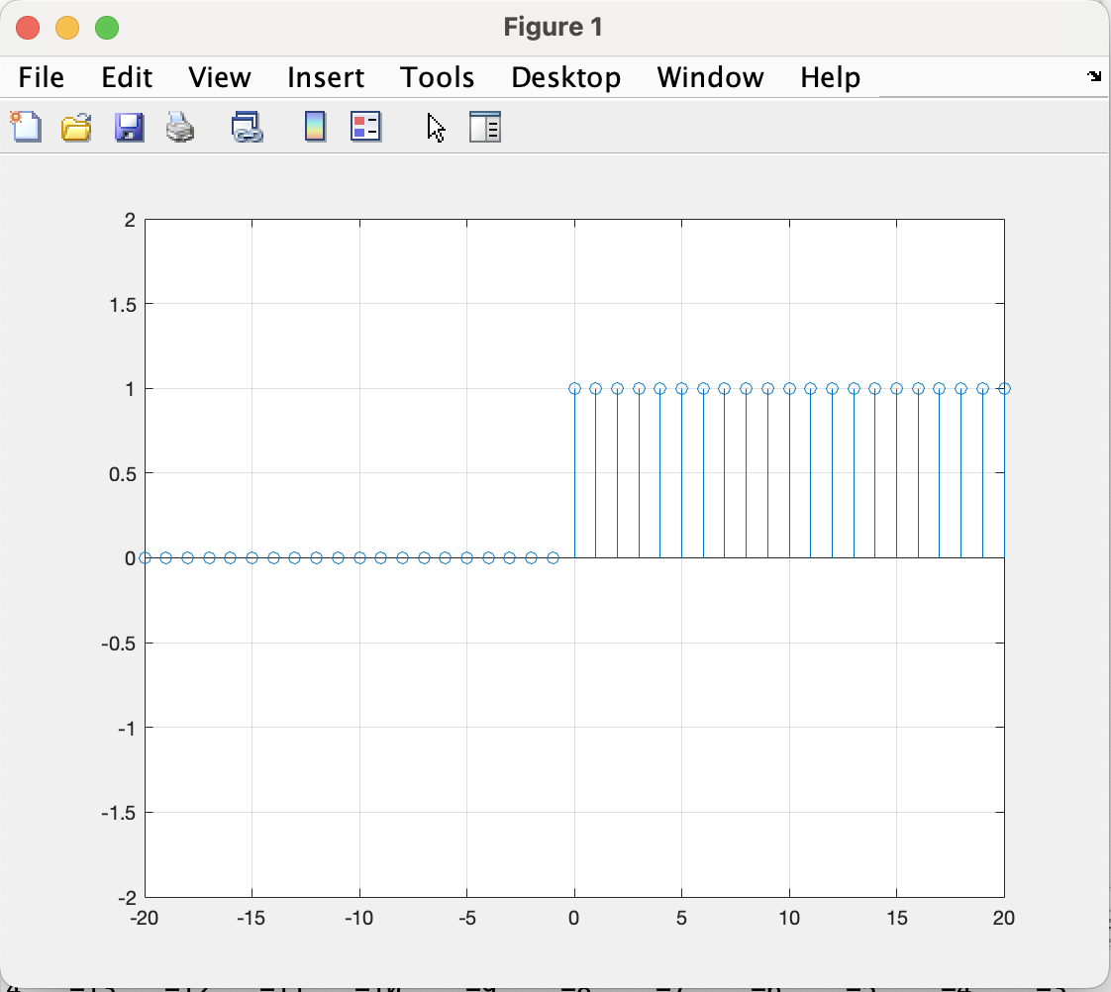
%U(n)%%%%%%%%%%%%%%%%%%%%%%%%%%%%%%%%%%%%%%%%%%%%%%%%%%%%%%%%%%%%%%%%%%
clc;clear all;
n = -20:1:20
unitstep1 = n>=0;
figure(1)
stem(n,unitstep1)
axis([-20,20,-2,2]);
grid on

Slide 15
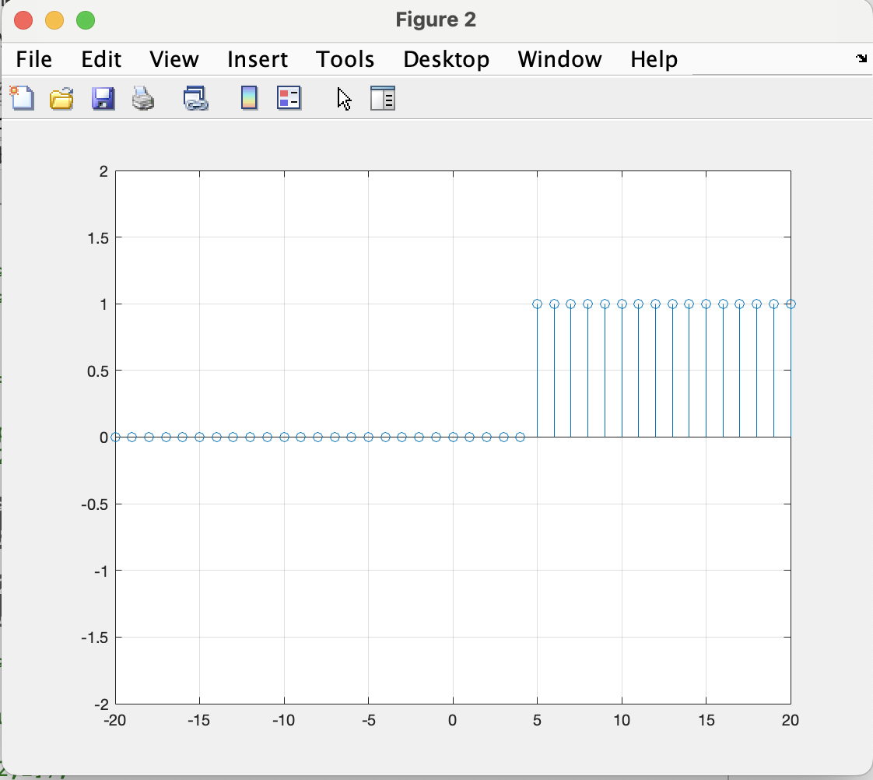
%U(n-4)%%%%%%%%%%%%%%%%%%%%%%%%%%%%%%%%%%%%%%%%%%%%%%%%%%%%%%%%%%%%%%%%
unitstep2 = n>4;
figure(2)
stem(n,unitstep2)
axis([-20,20,-2,2]);
grid on

Slide 16
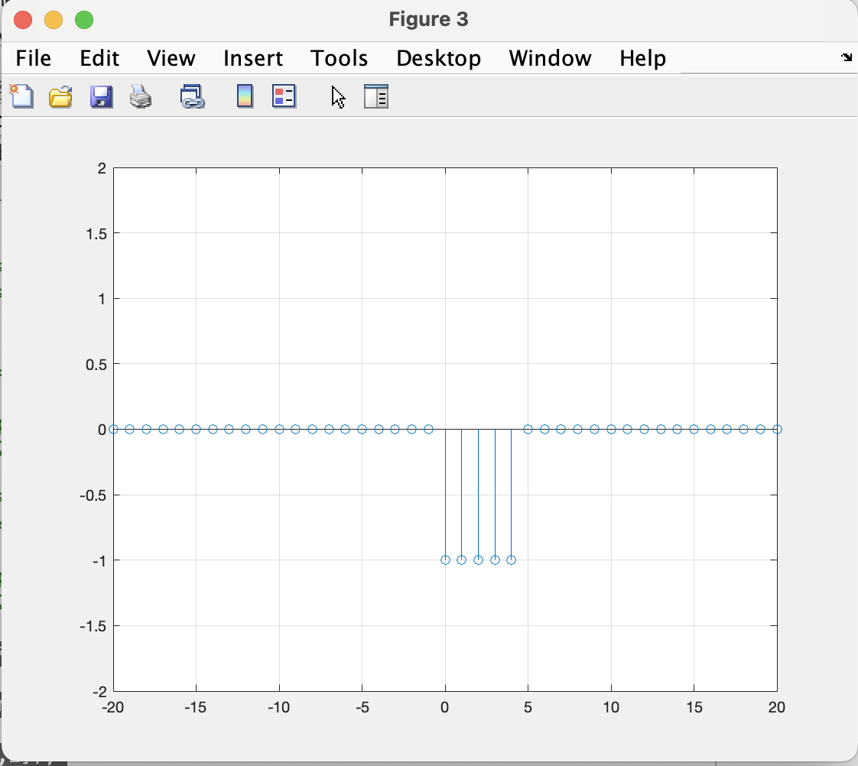
%U(n-4)-U(n)%%%%%%%%%%%%%%%%%%%%%%%%%%%%%%%%%%%%%%%%%%%%%%%%%%%%%%%%%%%
figure(3)
x = unitstep2-unitstep1;
stem(n,x);
axis([-20,20,-2,2]);
grid on

Slide 17
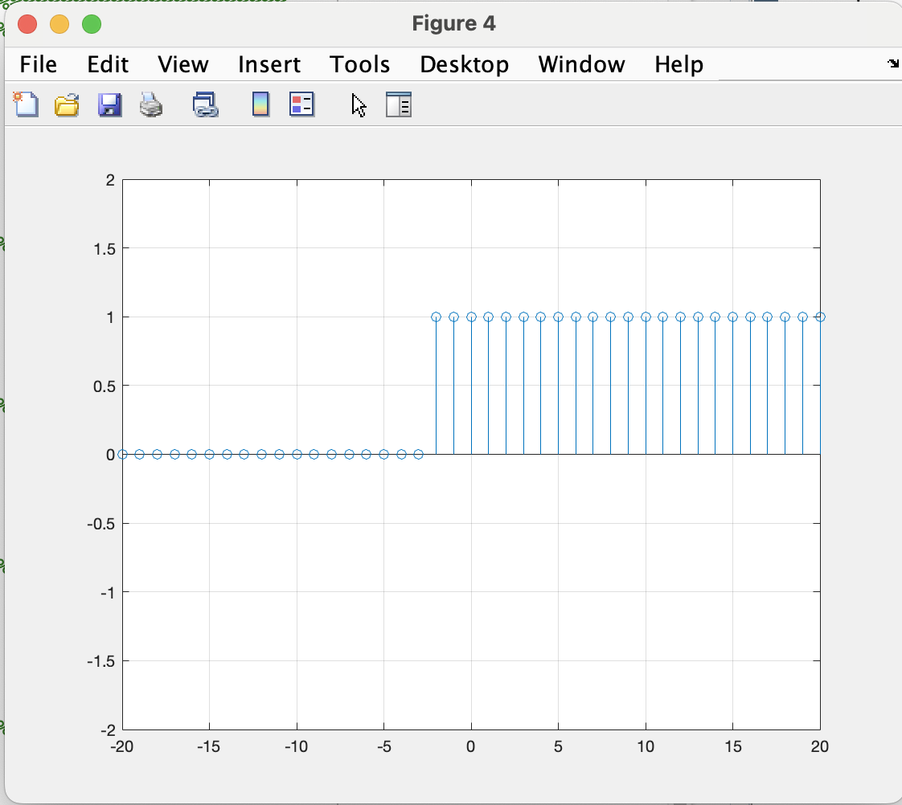
%U(n+2)%%%%%%%%%%%%%%%%%%%%%%%%%%%%%%%%%%%%%%%%%%%%%%%%%%%%%%%%%%%%%%%%
figure(4)
unitstep3=n>=-2;
stem(n,unitstep3)
axis([-20,20,-2,2]);
grid on

Slide 18
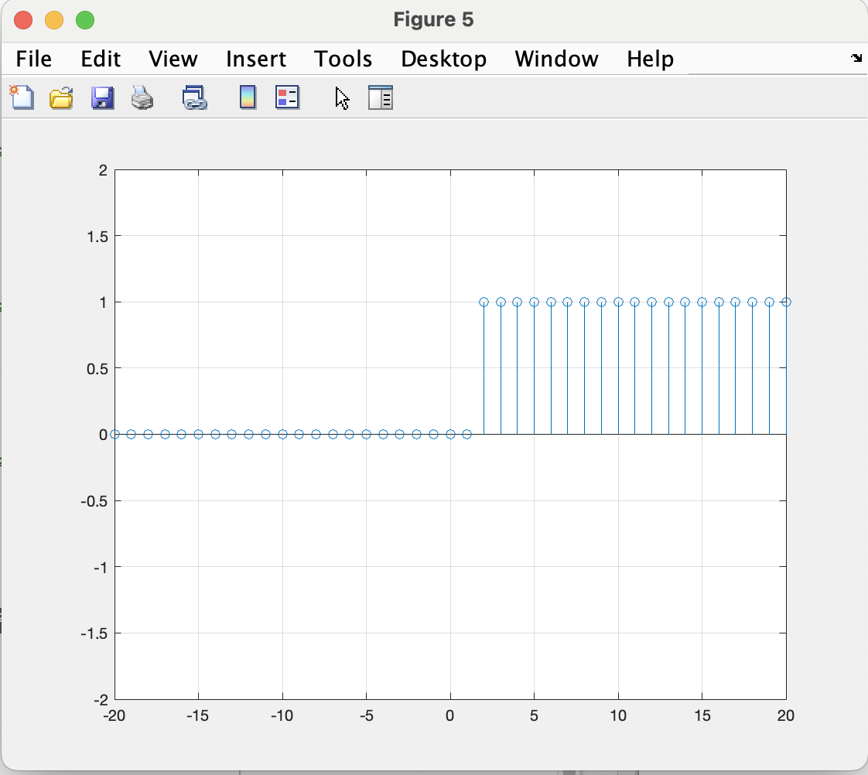
%U(n-2)%%%%%%%%%%%%%%%%%%%%%%%%%%%%%%%%%%%%%%%%%%%%%%%%%%%%%%%%%%%%%%%%
figure(5)
unitstep4 = n>=2;
stem(n,unitstep4)
axis([-20,20,-2,2]);
grid on

Slide 19
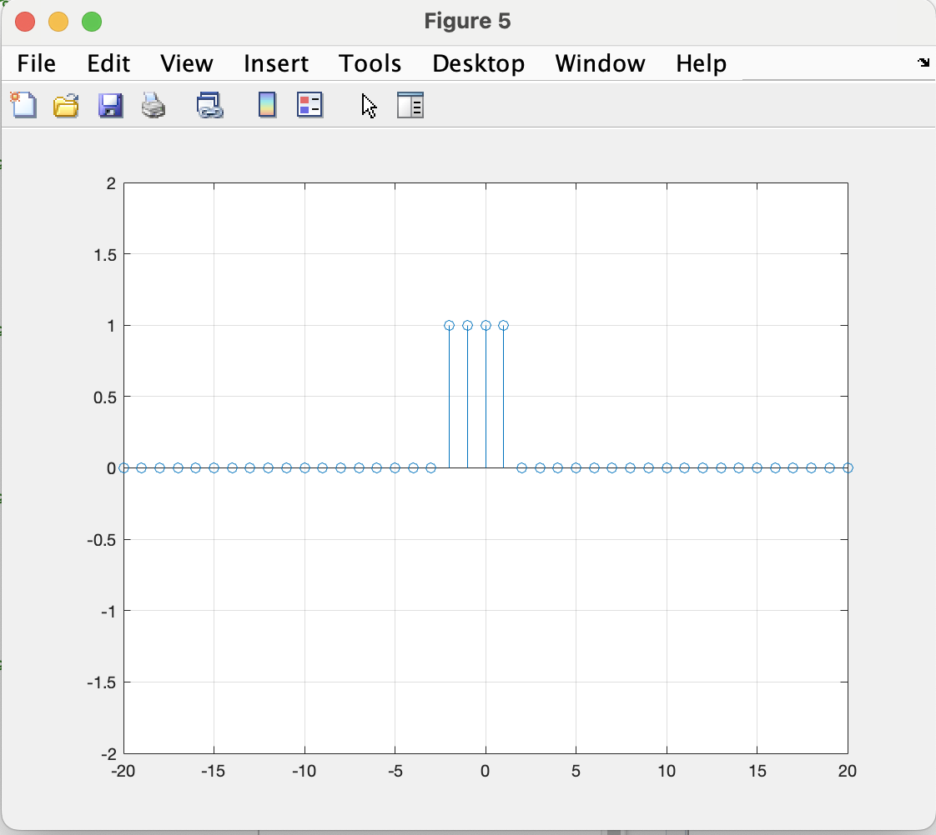
%U(n+2)-U(n-2)%%%%%%%%%%%%%%%%%%%%%%%%%%%%%%%%%%%%%%%%%%%%%%%%%%%%%%%%%%
figure(5)
h = unitstep3-unitstep4;
stem(n,h)
axis([-20,20,-2,2]);
grid on

Slide 20
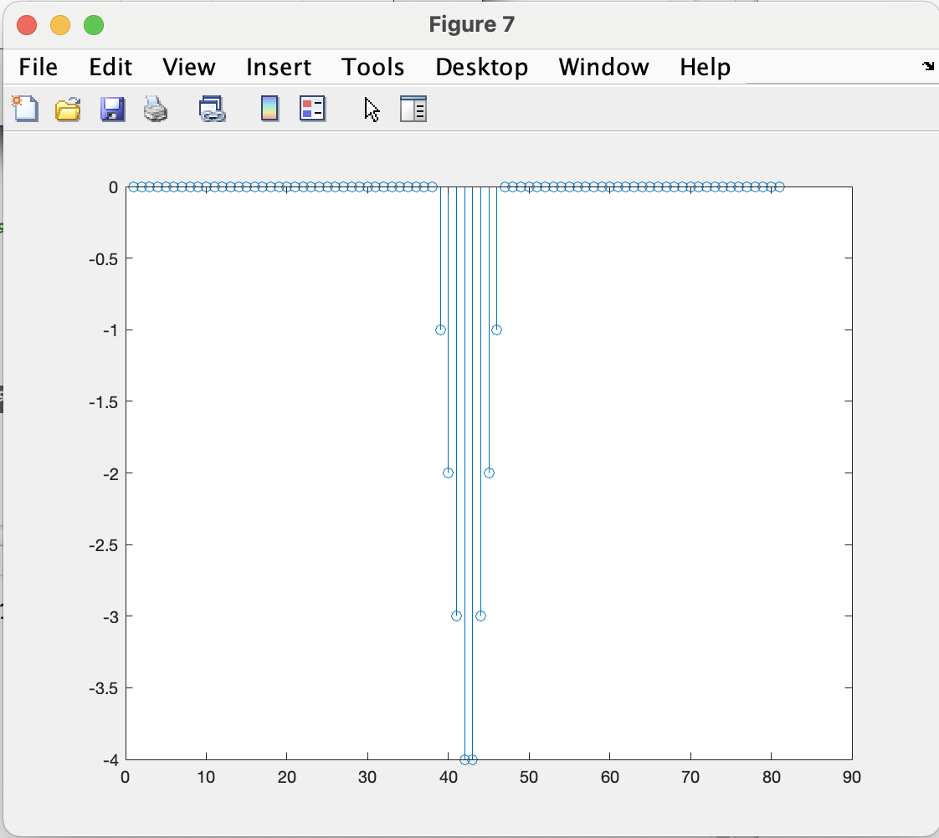
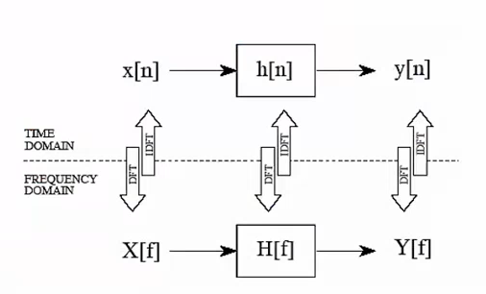
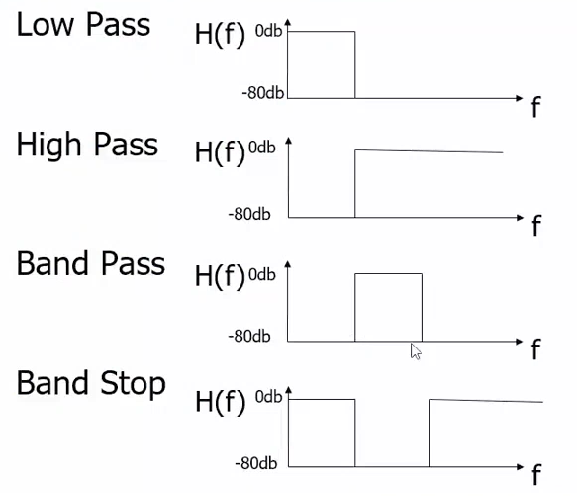
% convulation operator%%%%%%%%%%%%%%%%%%%%%%%%%%%%%%%%%%%%%%%%%%%%%%%%%%%
figure(7)
y = conv(x,h);
stem(y);
%axis([-20,20,-2,2]);
The figure 7 represent filter U(h) is the filter that is applied to the U(x)

Slide 21
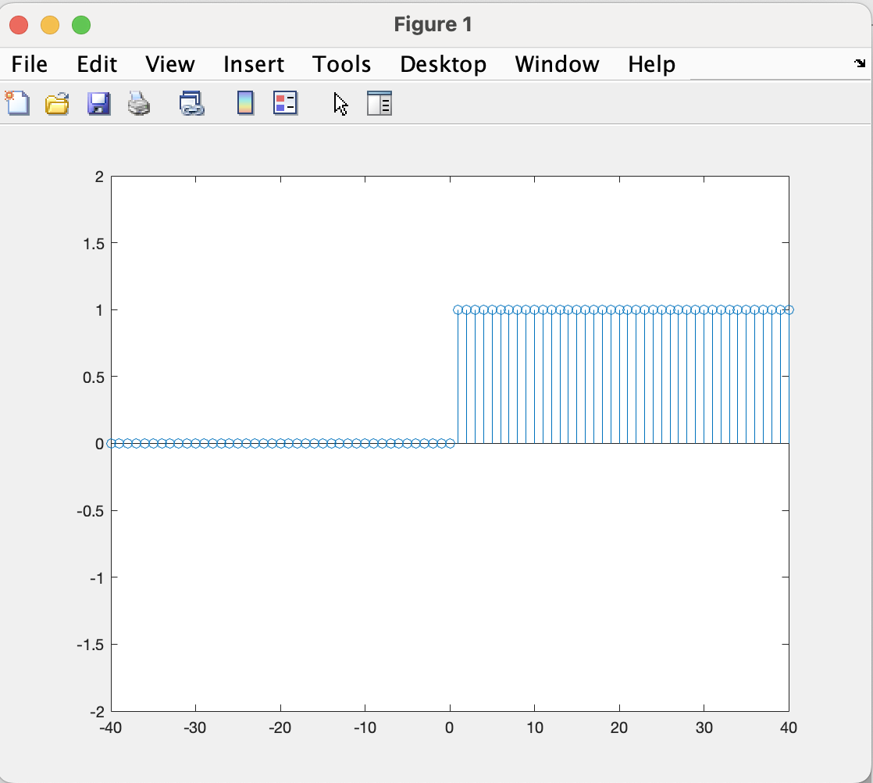
%U(n)%%%%%%%%%%%%%%%%%%%%%%%%%%%%%%%%%%%%%%%%%%%%%%%%%%%%%%%%%%%%%%%%%%
n = -40:1:40
unitstep1 = n>0;
figure(1)
stem(n,unitstep1)
axis([-40,40,-2,2]);

Slide 22
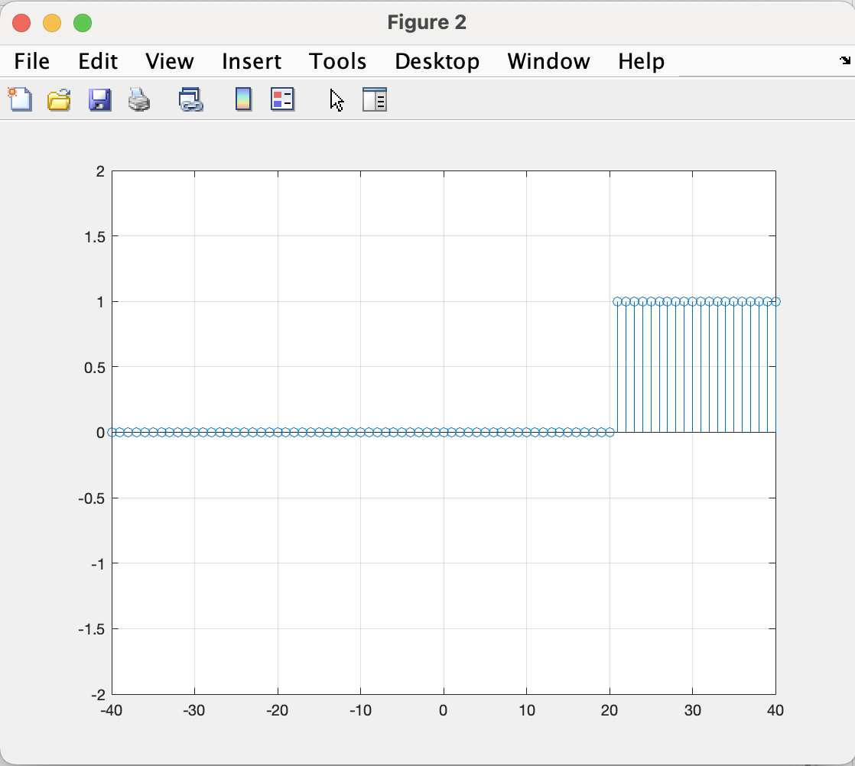
%U(n-20)%%%%%%%%%%%%%%%%%%%%%%%%%%%%%%%%%%%%%%%%%%%%%%%%%%%%%%%%%%%%%%%%
unitstep2 = n>20;
figure(2)
stem(n,unitstep2)
axis([-40,40,-2,2]);
grid on

Slide 23
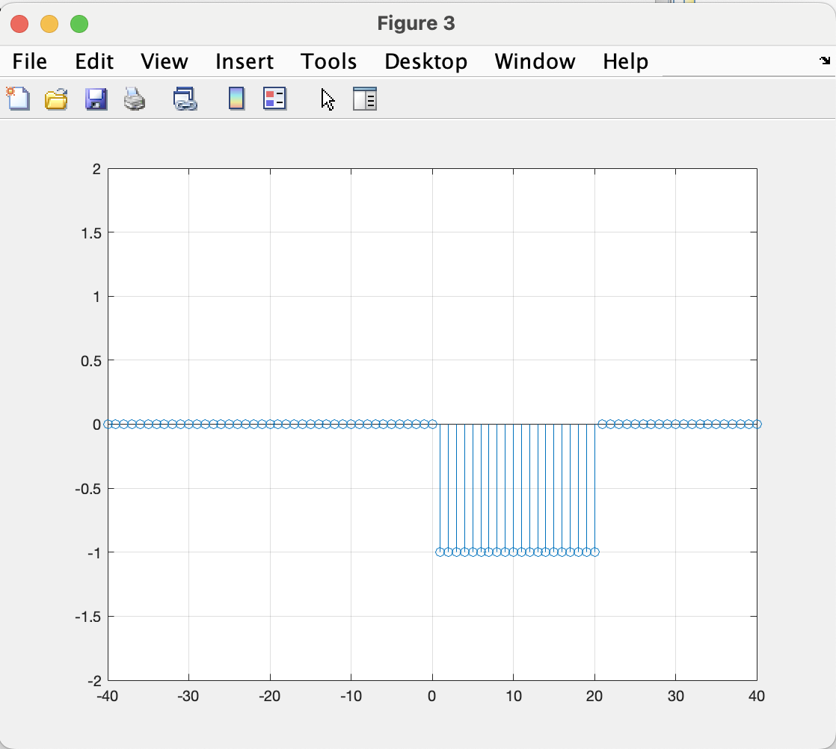
%U(n-20)-U(n)%%%%%%%%%%%%%%%%%%%%%%%%%%%%%%%%%%%%%%%%%%%%%%%%%%%%%%%%%%%
figure(3)
x = unitstep2-unitstep1;
stem(n,x);
axis([-40,40,-2,2]);
grid on

Slide 24
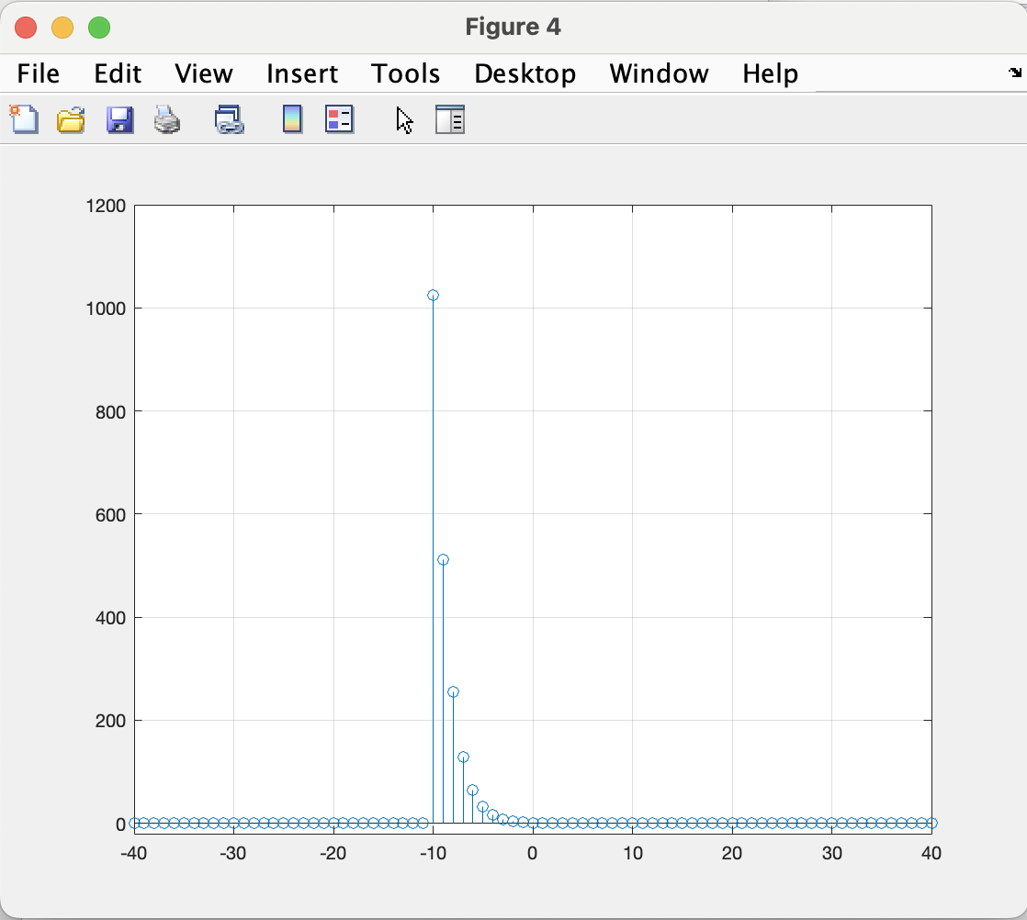
% ((1/2)^n)*(U(n+10))%%%%%%%%%%%%%%%%%%%%%%%%%%%%%%%%%%%%%%%%%%%%%%%%%%%
figure(4)
p = 0.5.^n;
q = n>=-10;
unitstep3 = p.*q;
stem(n,unitstep3);
axis([-40,40,-20,1200]);
grid on

Slide 25
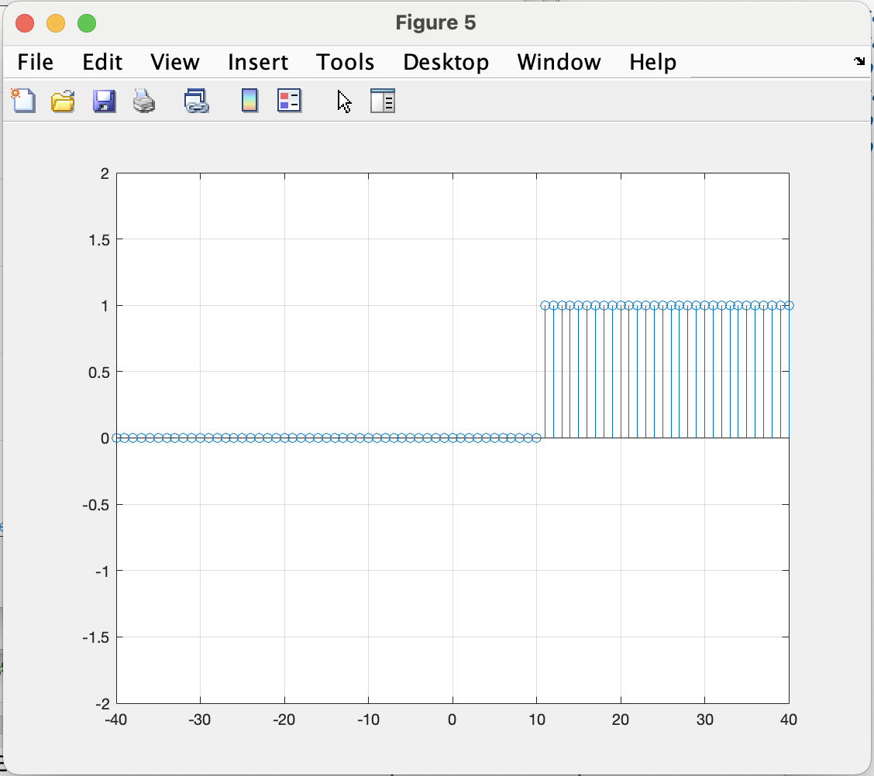
% U(n-10)%%%%%%%%%%%%%%%%%%%%%%%%%%%%%%%%%%%%%%%%%%%%%%%%%%%%%%%%%%%%%%
figure(5)
unitstep4 = n>10;
stem(n,unitstep4)
axis([-40,40,-2,2]);
grid on

Slide 26
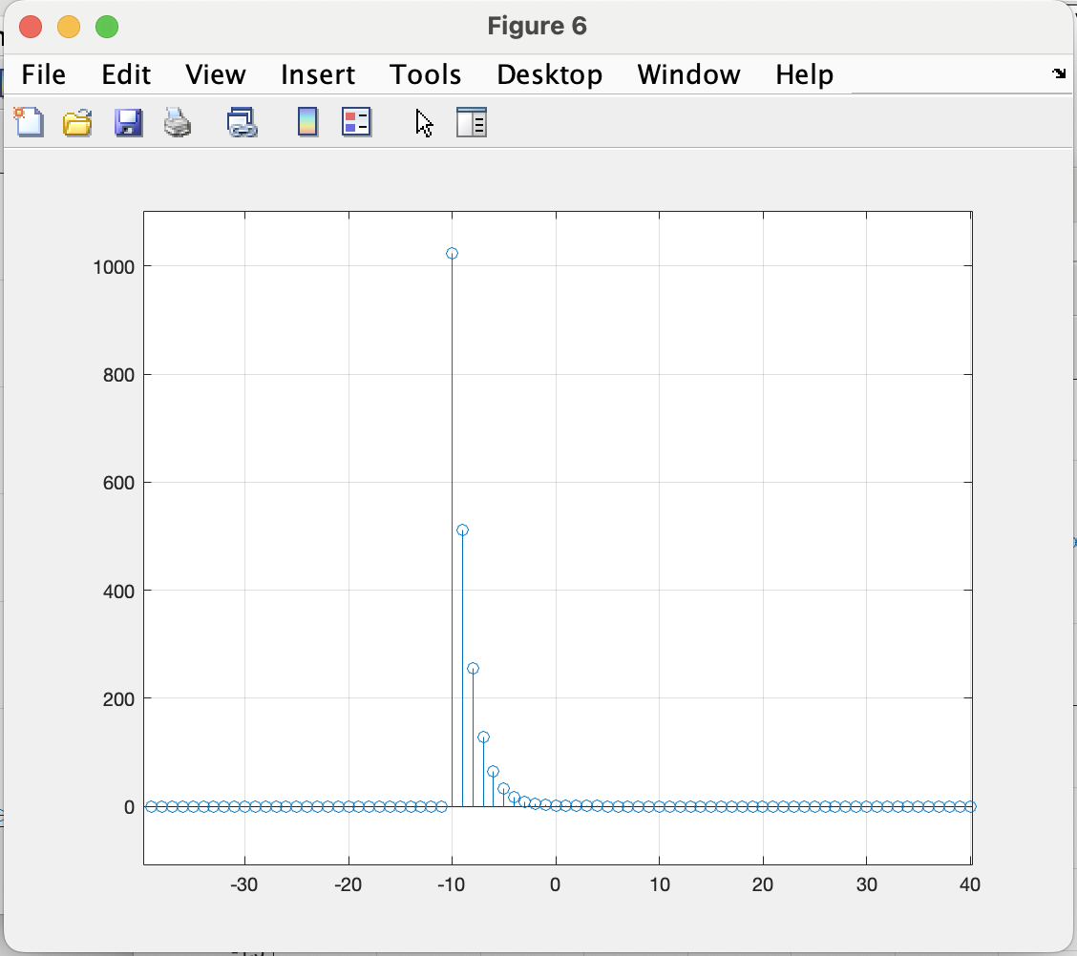
%((1/2)^n)*(U(n+10))-(U(n-10))%%%%%%%%%%%%%%%%%%%%%%%%%%%%%%%%%%%%%%%%%%
figure(6)
h = unitstep3 - unitstep4
stem(n,h);
axis([-40,40,-1200,10]);
grid on

Slide 27
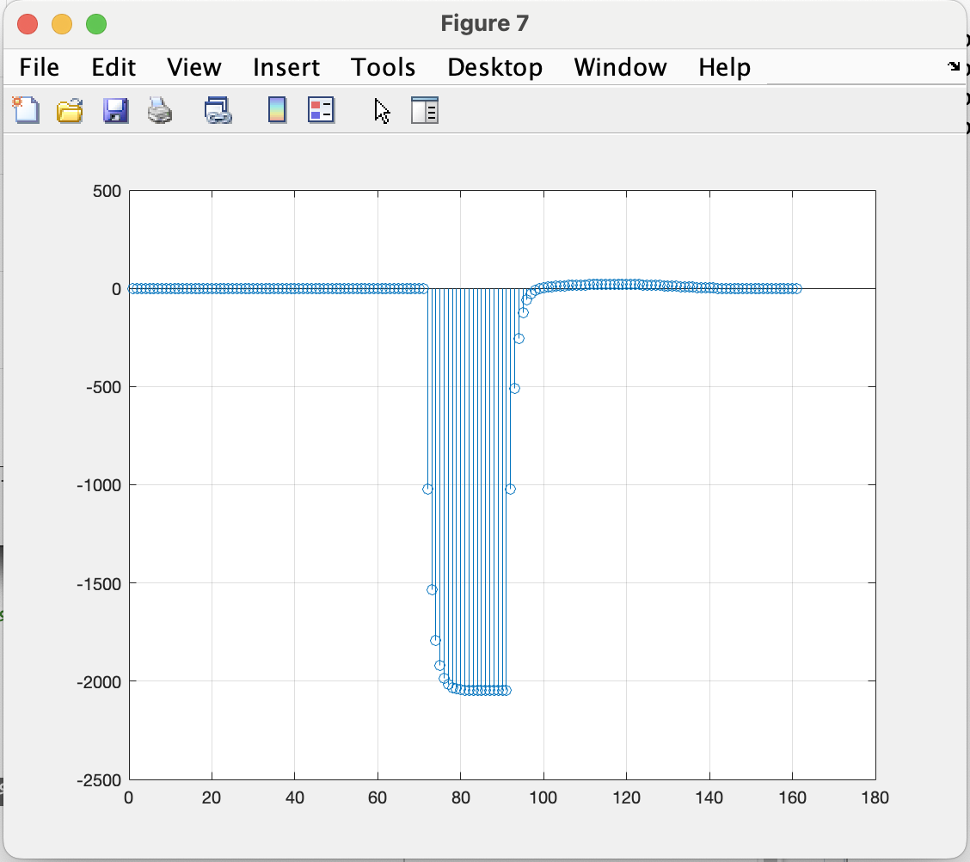
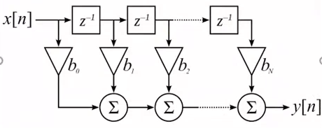
% convolution %%%%%%%%%%%%%%%%%%%%%%%%%%%%%%%%%%%%%%%%%%%%%%%%%%%%%%%%%%
figure(7)
y = conv(x,h);
stem(y);
%axis([-20,20,-2,2]);
grid on

Slide 28
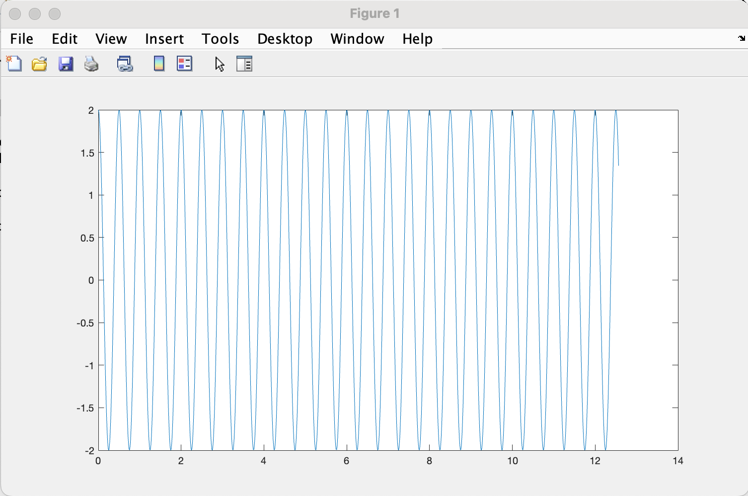
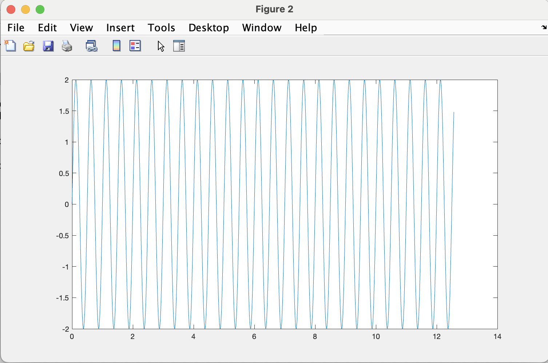
%Q1.A%%%%%%%%%%%%%%%%%%%%%%%%%%%%%%%%%%%%%%%%%%%%%%%%%%%%%%%%%%%%%%%%%%%%
clc;
clear all;
t=0:2*pi/500:4*pi;
x=exp(4j*pi*t)+exp(-j*4*pi*t)
figure(1)
plot(t,x)
x=(exp(j*4*pi*t)-exp(-j*4*pi*t))/j;
figure(2)
plot(t,x)

Slide 29
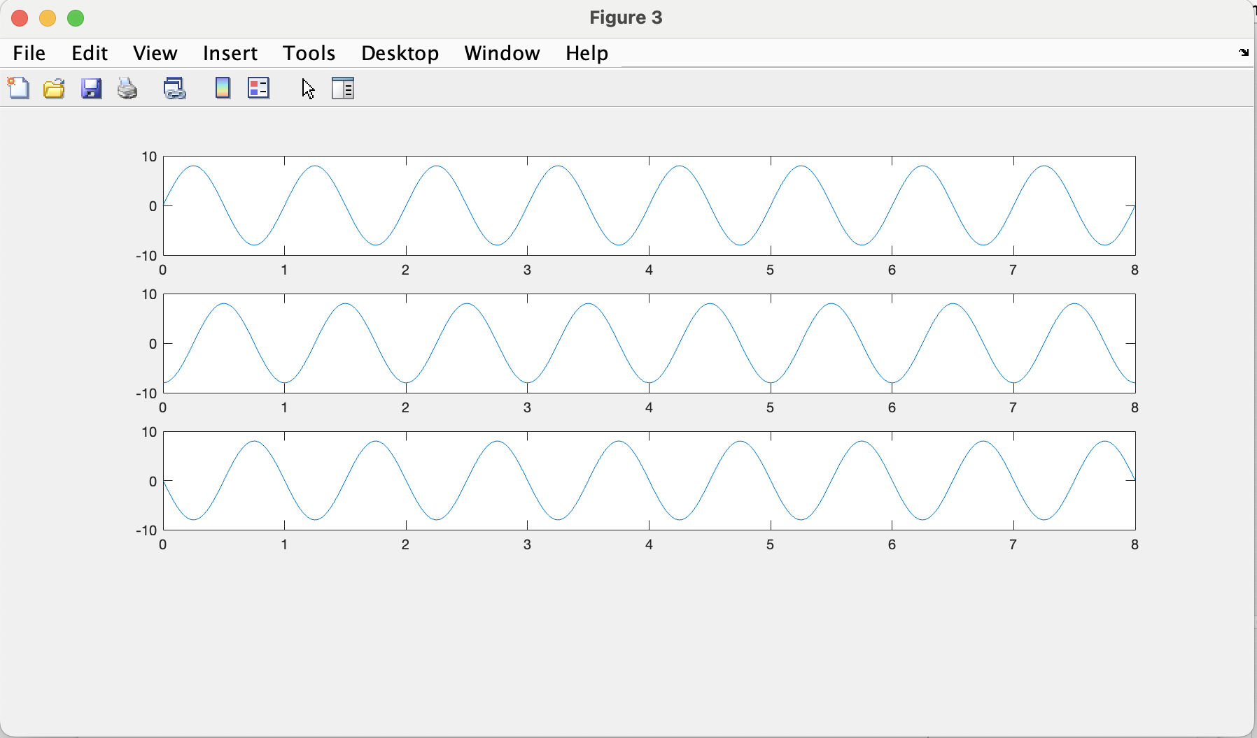
%Q1.B%%%%%%%%%%%%%%%%%%%%%%%%%%%%%%%%%%%%%%%%%%%%%%%%%%%%%%%%%%%%%%%%%%%%
clc;
clear all;
t=0:0.01:8;
theta=-pi/2;
z=8*cos(2*pi*t+theta);
figure(3)
subplot(4,1,1)
plot(t,z)
theta=-pi;
z=8*cos(2*pi*t+theta);
figure(3)
subplot(4,1,2)
plot(t,z)
theta=-3*pi/2;
z=8*cos(2*pi*t+theta);
figure(3)
subplot(4,1,3)
plot(t,z)

Slide 30
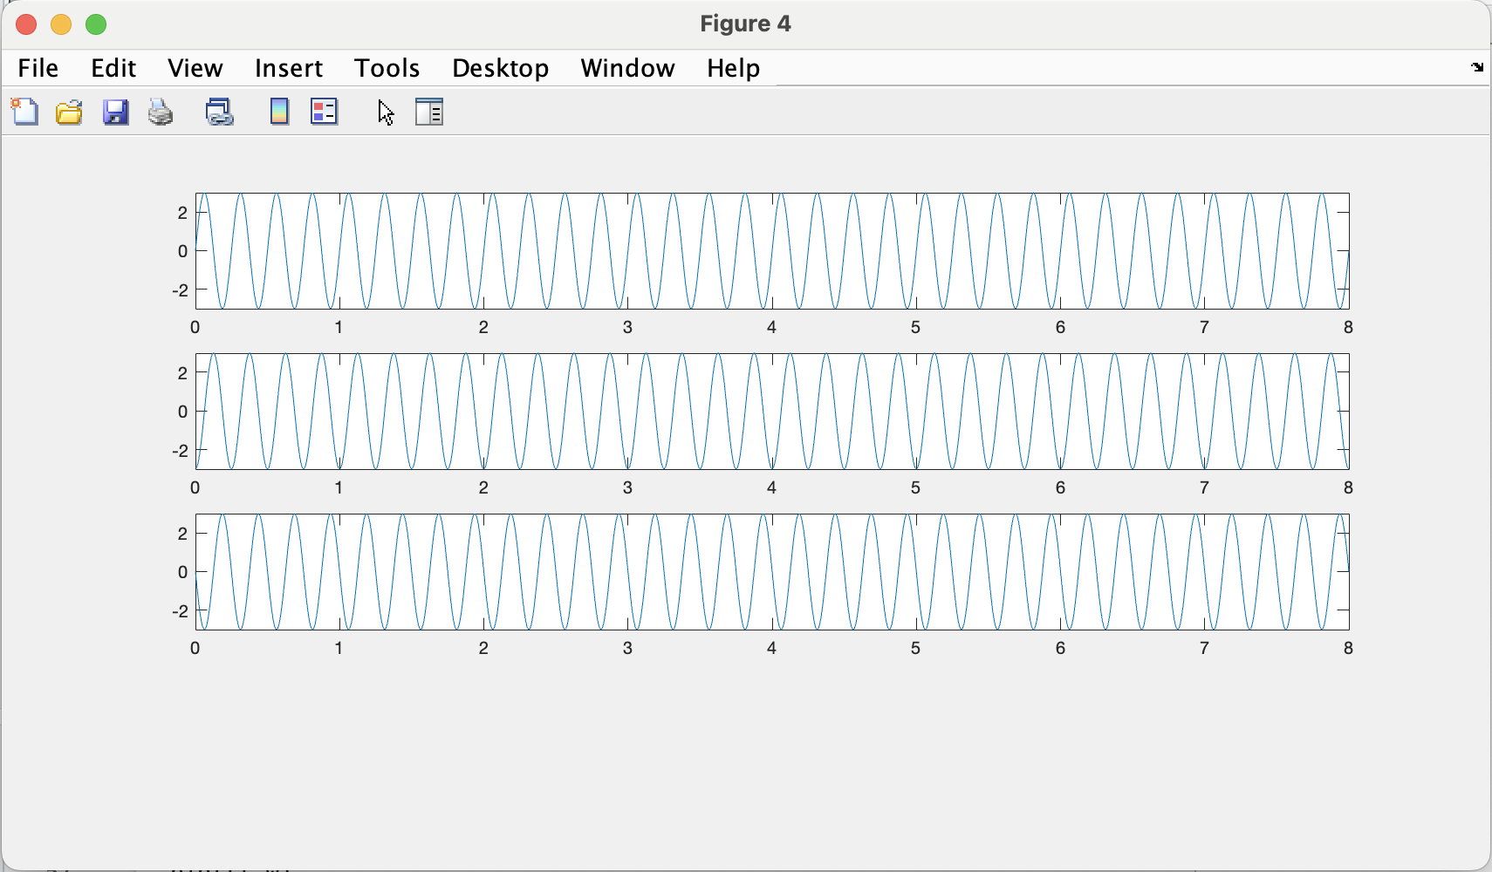
%Q1.C%%%%%%%%%%%%%%%%%%%%%%%%%%%%%%%%%%%%%%%%%%%%%%%%%%%%%%%%%%%%%%%%%%%%
clc;
clear all;
t=0:0.01:8;
theta=-pi/2;
w=3*cos(8*pi*t+theta);
figure(4)
subplot(4,1,1)
plot(t,w)
theta=-pi;
w=3*cos(8*pi*t+theta);
figure(4)
subplot(4,1,2)
plot(t,w)
theta=-3*pi/2;
w=3*cos(8*pi*t+theta);
figure(4)
subplot(4,1,3)
plot(t,w)

Slide 31
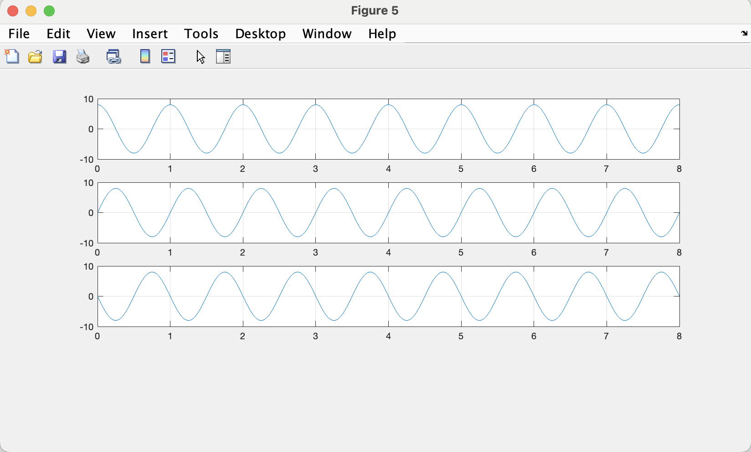
%Q1.D-B%%%%%%%%%%%%%%%%%%%%%%%%%%%%%%%%%%%%%%%%%%%%%%%%%%%%%%%%%%%%%%%%%%
clc;
clear all;
t=0:0.01:8;
T=1;
tor=0;
x=8*cos(2*pi*(t-tor/T))
figure(5)
subplot(4,1,1)
plot(t,x)
grid on
tor=0.25;
x=8*cos(2*pi*(t-tor/T))
subplot(4,1,2)
plot(t,x)
grid on
tor=0.75;
x=8*cos(2*pi*(t-tor/T))
subplot(4,1,3)
plot(t,x)
grid on

Slide 32
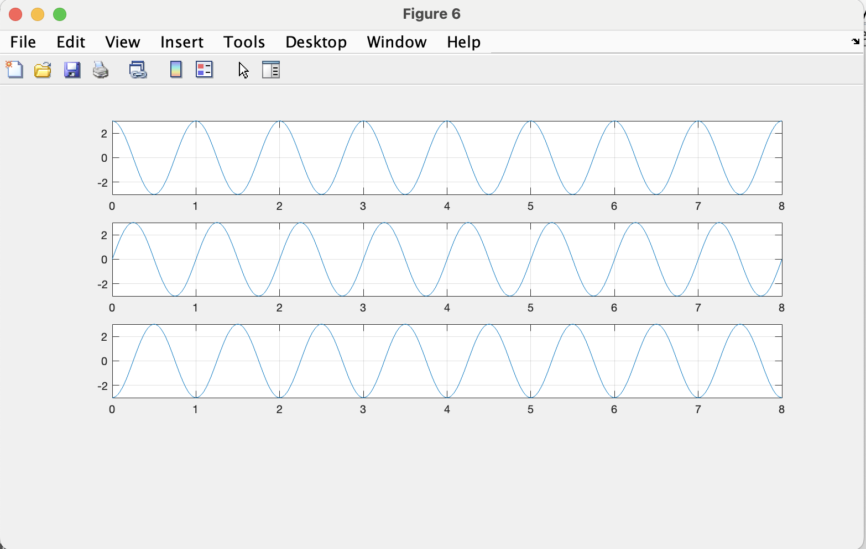
% Q1.D-C%%%%%%%%%%%%%%%%%%%%%%%%%%%%%%%%%%%%%%%%%%%%%%%%%%%%%%%%%%%%%%%%%
clc;
clear all;
t=0:0.01:8;
T=0.25;
tor=0;
x=3*cos(2*pi*(t-tor/T));
figure(6)
subplot(4,1,1)
plot(t,x)
grid on
tor=0.0625;
x=3*cos(2*pi*(t-tor/T));
figure(6)
subplot(4,1,2)
plot(t,x)
grid on
tor=0.125;
x=3*cos(2*pi*(t-tor/T));
figure(6)
subplot(4,1,3)
plot(t,x)
grid on

Slide 33
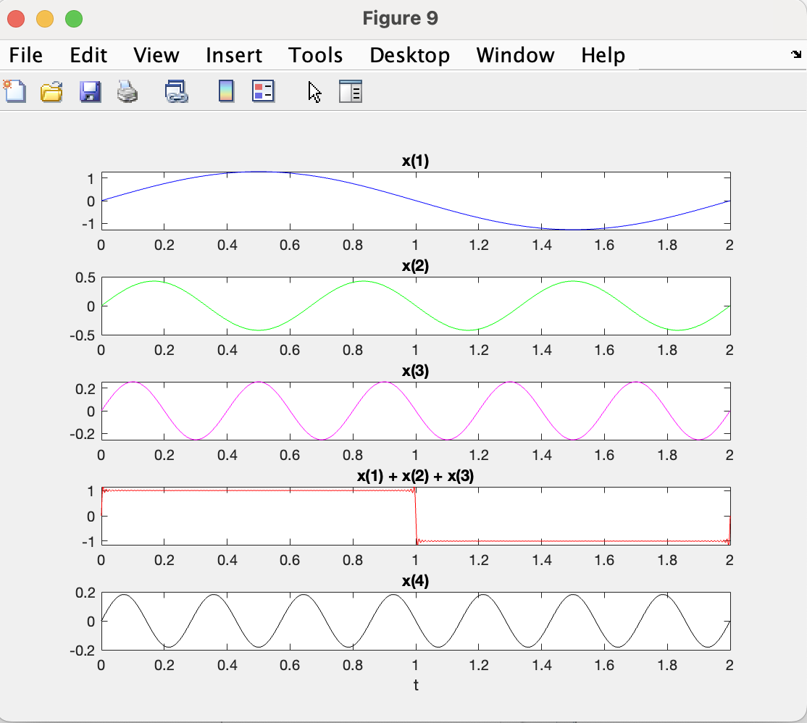
%Q2.A%%%%%%%%%%%%%%%%%%%%%%%%%%%%%%%%%%%%%%%%%%%%%%%%%%%%%%%%%%%%%%%%%%%%
clear, clc
N = 100; % define the number of terms of the F.S.
t = 0:0.002:2; % define the time index with fine resolution
T = 2;
omega_0 = 2*pi/T;%!!!!!!!this is omega value!!!!!!!!!!!!it valiue is PI!!!!!!
x_N = zeros(size(t));
for n = 1:N
x_N = x_N + (4/pi)*(1/(2*n - 1))*sin((2*n - 1)*omega_0*t);
end
figure(9)
subplot(5,1,1)
plot(t, (4/pi)*(1/(2*1 - 1))*sin((2*1 - 1)*omega_0*t), 'b')
title('x(1)')
subplot(5,1,2)
plot(t, (4/pi)*(1/(2*2 - 1))*sin((2*2 - 1)*omega_0*t), 'g')
title('x(2)')
subplot(5,1,3)
plot(t, (4/pi)*(1/(2*3 - 1))*sin((2*3 - 1)*omega_0*t), 'm')
title('x(3)')
subplot(5,1,4)
plot(t, x_N, 'r')
title('x(1) + x(2) + x(3)')
subplot(5,1,5)
plot(t, (4/pi)*(1/(2*4 - 1))*sin((2*4 - 1)*omega_0*t), 'k')
title('x(4)')
xlabel('t')

Slide 34
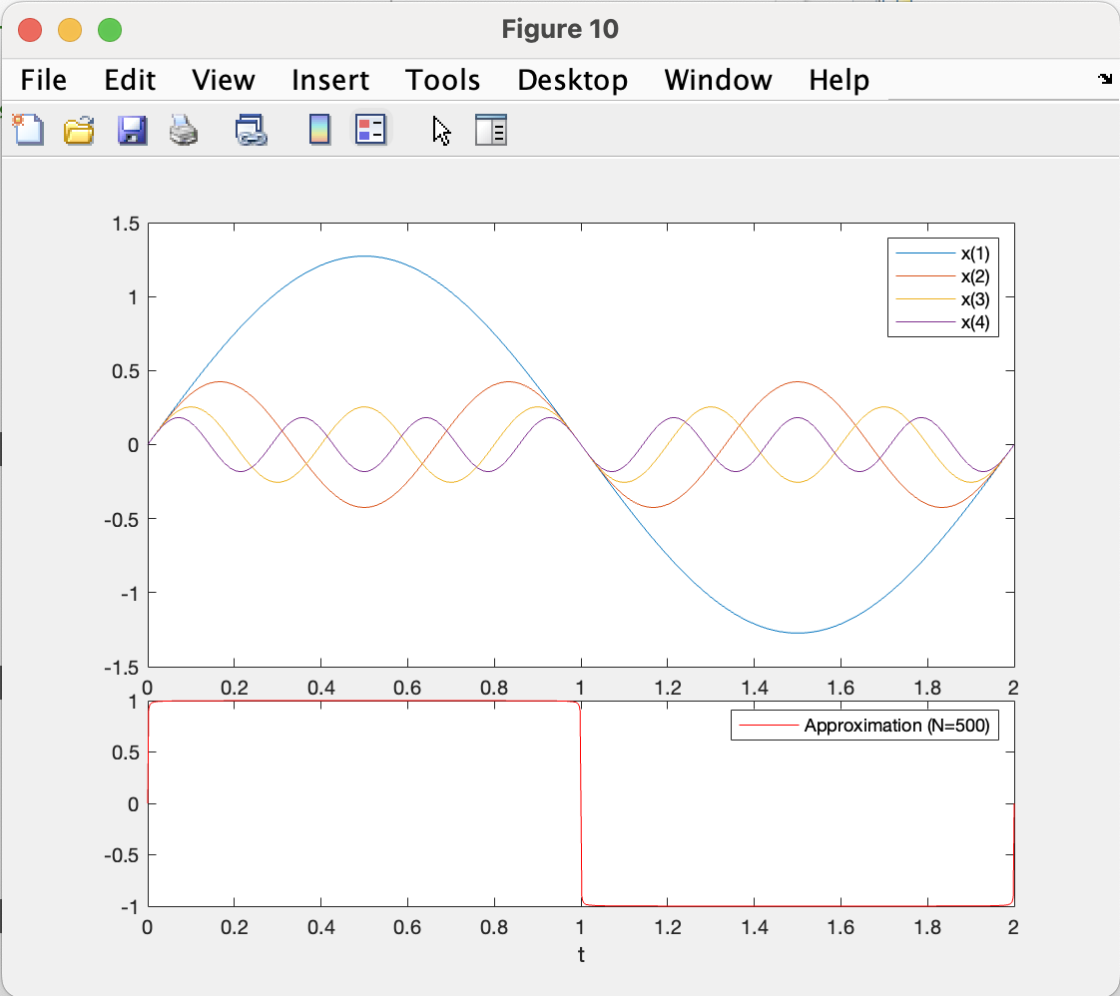
clear, clc
n = 500; % Set the number of terms to 50
t = 0:0.002:2; % Time vector
T = 2;
% Initialize x to store the terms
x = zeros(n, length(t));
for i = 1:n
x(i,:) = (4/pi)*(1/((2*i)-1)*sin(2*pi*((2*i)-1)*t/T));
end
% Plot individual terms and their sum
figure(10)
subplot(6,1,1:4)
for i = 1:4
plot(t, x(i,:), 'DisplayName', ['x(', num2str(i), ')']), hold on
end
hold off
xlabel('t')
legend('show')
subplot(6,1,5:6)
plot(t, sum(x(1:n,:), 1), 'r', 'DisplayName', 'Approximation (N=500)')
xlabel('t')
legend('show')

Slide 35
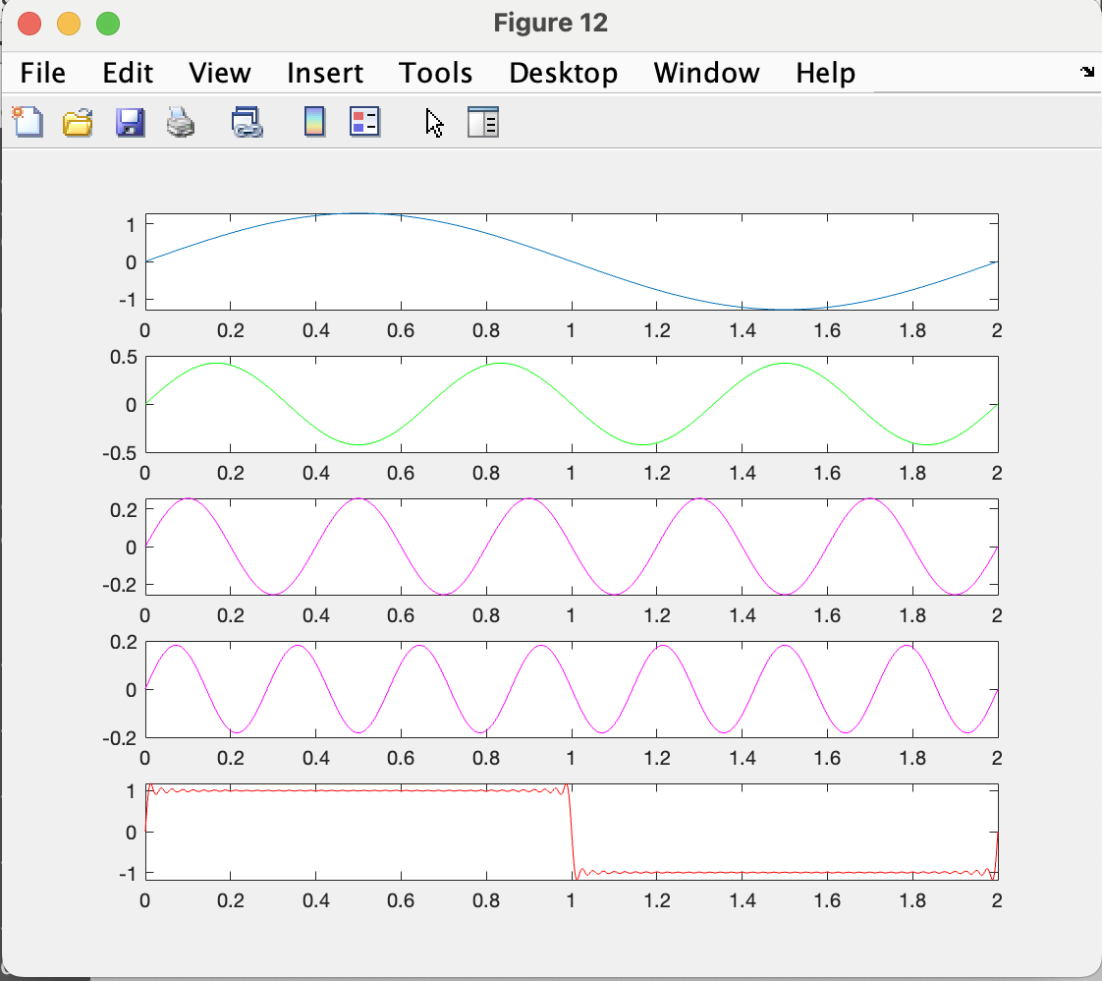
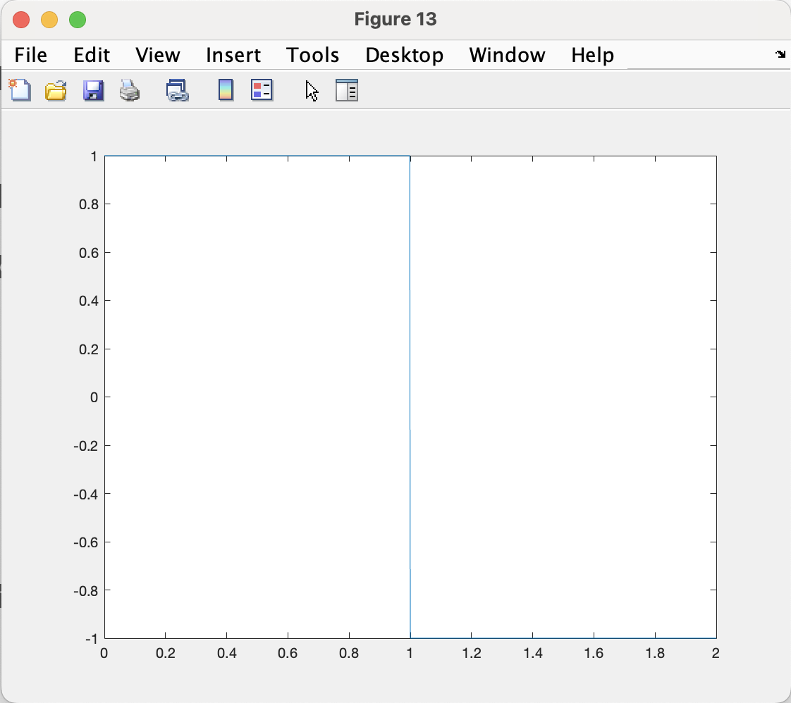
%Q2.C%%%%%%%%%%%%%%%%%%%%%%%%%%%%%%%%%%%%%%%%%%%%%%%%%%%%%%%%%%%%%%%%%%%%
%Example code
clear, clc
n=40; %define the number of terms of the F.S>
%define the time index. The range is from[0:1],but with
%step size of 0.002 for fine resolution
t = 0:0.002:2;
T=2;
for i = 1:n
x(i,:) =(4/pi)*(1/((2*i)-1)*sin(2*pi*((2*i)-1)*t/T));
end
%plot the first term, the second term
%the third term, and the Sum of teh first three terms
%approch:
figure(12)
subplot(5,1,1)
plot(t,x(1,:)) %plot the first term
subplot(5,1,2)
plot(t,x(2,:),'g')%plot the second term
subplot(5,1,3)
plot(t,x(3,:),'m')%plot the third term
subplot(5,1,4)
plot(t,x(4,:),'m')%plot the third term
subplot(5,1,5)
plot(t,sum(x(1:n,:),1),'r')
hold on
unitstep1 = t>=0; %equavalent to if t >= 0 unitstep1 = True else unitstep1 =False end
unitstep2 = t>=1;
figure (13)
plot(t,unitstep1-2*unitstep2)
hold off

Slide 36
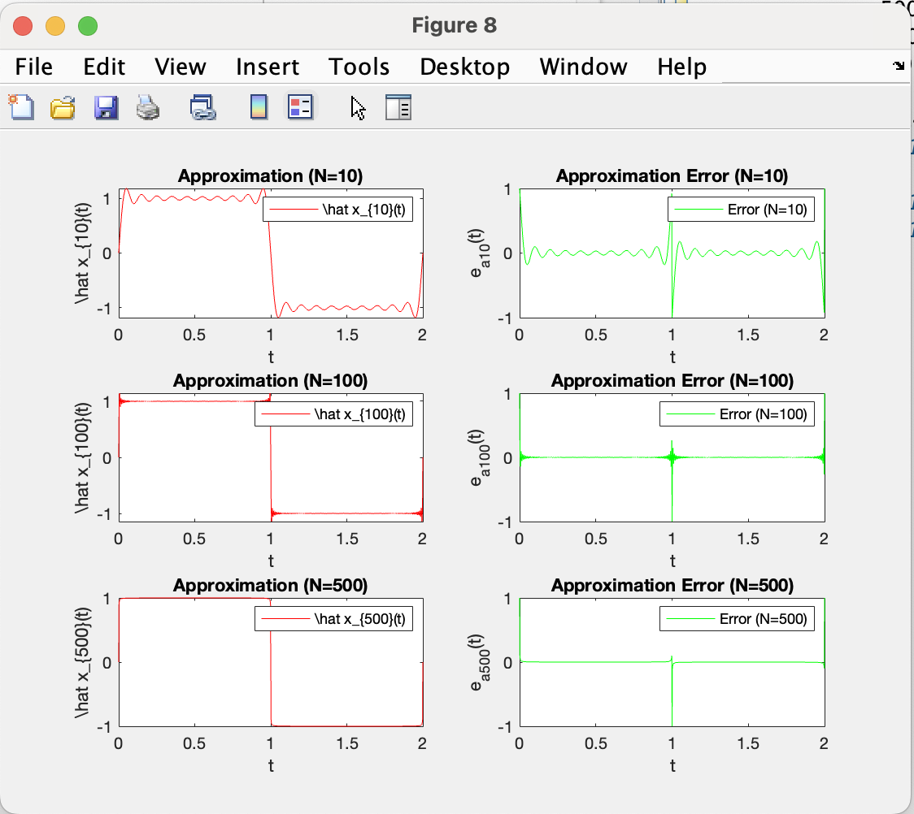
%Q2.D%%%%%%%%%%%%%%%%%%%%%%%%%%%%%%%%%%%%%%%%%%%%%%%%%%%%%%%%%%%%%%%%%%%%
clear, clc
% Define parameters
t = 0:0.002:2; % Define the time index with fine resolution
T = 2;
omega_0 = 2*pi/T;
% Generate the square wave function x(t)
x_t = square(2*pi*t/T);
% Initialize variables for different approximations
N_values = [10, 100, 500];
num_N_values = numel(N_values);
% Plot subplots
figure(8)
for i = 1:num_N_values
N = N_values(i);
% Calculate Fourier series approximation
x_N = zeros(size(t));
for n = 1:N
x_N = x_N + (4/pi)*(1/(2*n - 1))*sin((2*n - 1)*omega_0*t);
end
% Calculate the approximation error e_a(t)
e_a_t = x_t - x_N;
% Plot results in subplots
subplot(num_N_values, 2, 2*i-1)
plot(t, x_N, 'r', 'DisplayName', ['\hat x_{' num2str(N) '}(t)'])
xlabel('t')
ylabel(['\hat x_{' num2str(N) '}(t)'])
title(['Approximation (N=' num2str(N) ')'])
legend('show')
subplot(num_N_values, 2, 2*i)
plot(t, e_a_t, 'g', 'DisplayName', ['Error (N=' num2str(N) ')'])
xlabel('t')
ylabel(['e_a_{' num2str(N) '}(t)'])
title(['Approximation Error (N=' num2str(N) ')'])
legend('show')
end

Slide 37
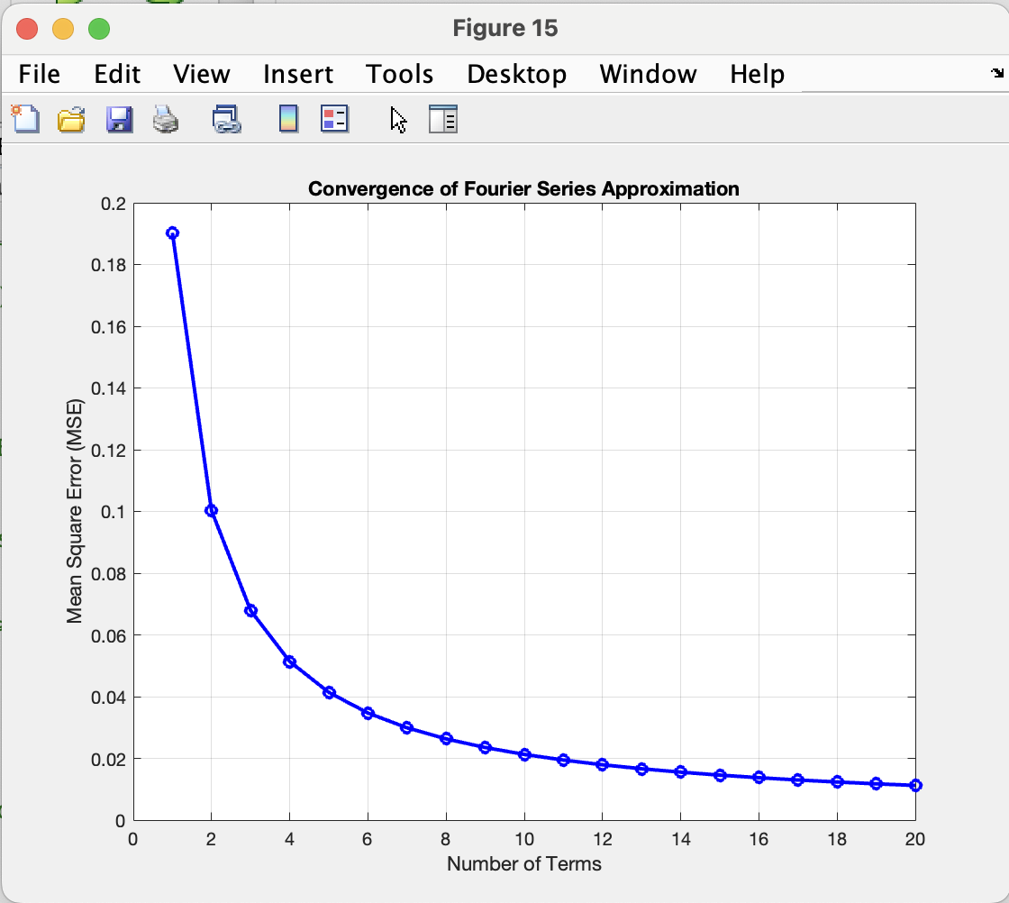
%Q2.E%%%%%%%%%%%%%%%%%%%%%%%%%%%%%%%%%%%%%%%%%%%%%%%%%%%%%%%%%%%%%%%%%%%%
clear, clc
% Define parameters
t = 0:0.002:2; % Time vector
T = 2;
num_terms = 20; % Maximum number of terms to consider
mse_values = zeros(1, num_terms);
for n = 1:num_terms
% Compute Fourier Series terms
x = zeros(n, length(t));
for i = 1:n
x(i,:) = (4/pi)*(1/((2*i)-1)*sin(2*pi*((2*i)-1)*t/T));
end
% Compute the sum of the first n terms
syw = sum(x(1:n,:), 1);
% Generate square wave
unitstep1 = t >= 0;
unitstep2 = t >= 1;
sqw = unitstep1 - 2*unitstep2;
% Compute Mean Square Error (MSE)
er = mean((sqw - syw).^2);
mse_values(n) = er;
end
% Plot the Mean Square Error (MSE) with regard to the number of terms
figure(15)
plot(1:num_terms, mse_values, 'bo-', 'LineWidth', 2)
xlabel('Number of Terms')
ylabel('Mean Square Error (MSE)')
title('Convergence of Fourier Series Approximation')
grid on

Slide 38
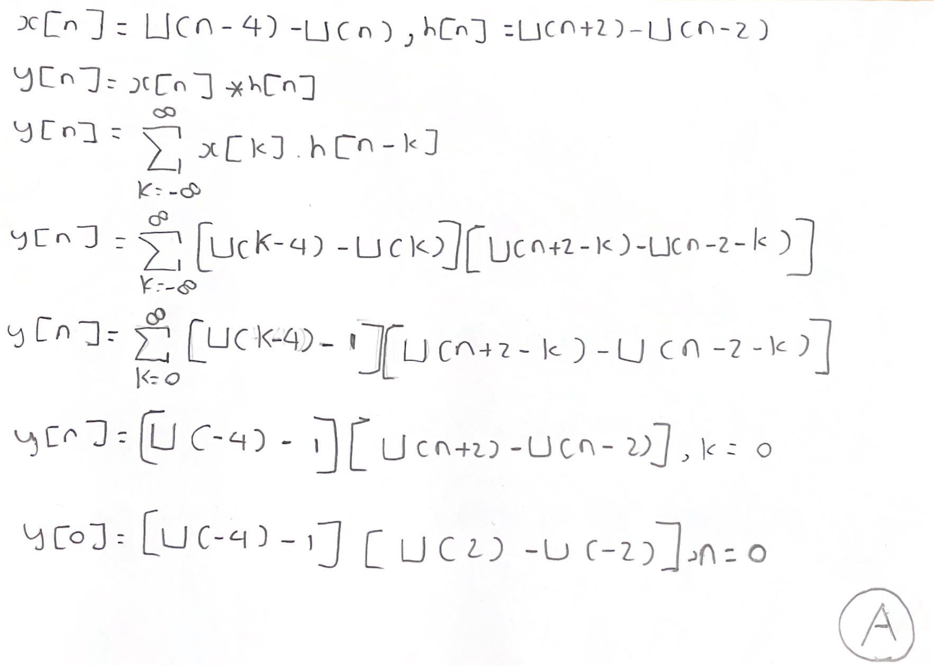

Slide 39
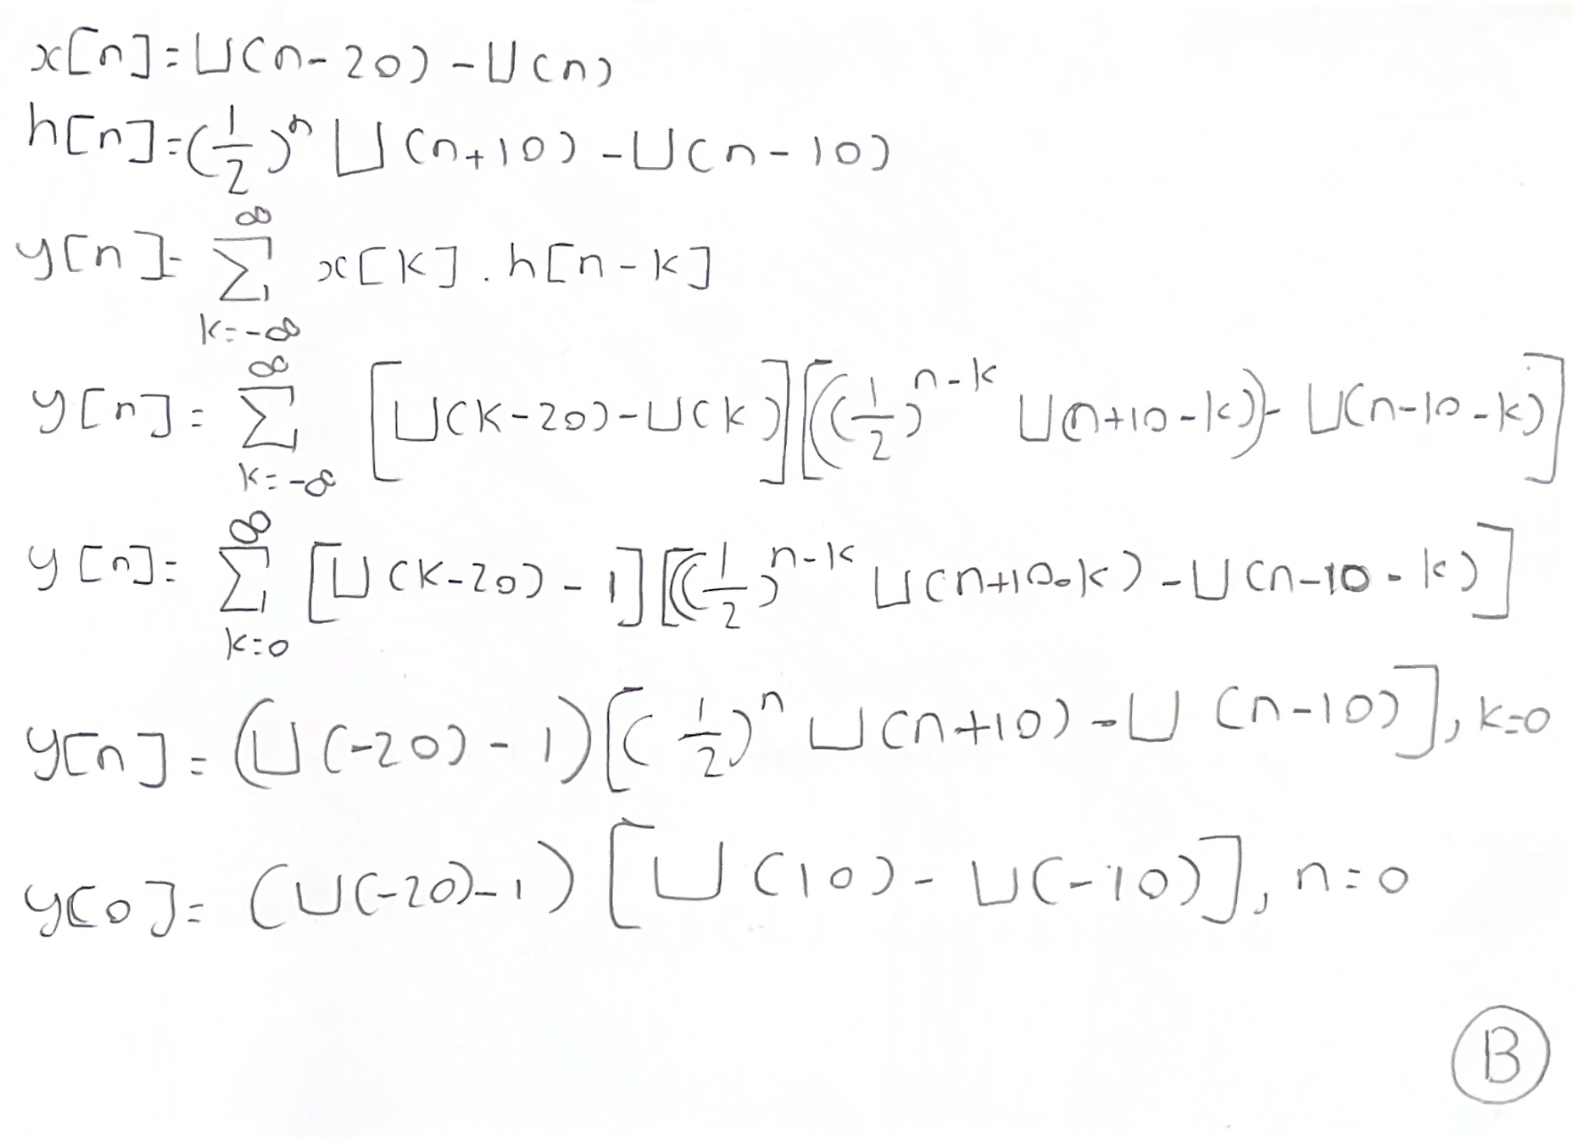

Slide 40
